Slide 1
CMSC204
Kartchner
V(StateGraph) = {Oregon, Alaska, Texas, Hawaii, Vermont, NewYork, California}
E(StateGraph) = {(Alaska, Oregon), (Hawaii, Alaska), (Hawaii, Texas), (Texas, Hawaii), (Hawaii, California), (Hawaii, New York), (Texas, Vermont), (Vermont, California), (Vermont, Alaska)}
1. Draw the StateGraph
AK
NY
OR
HI
CA
TX
VT

Slide 2
a. Show the adjacency matrix that would describe the edges in the graph. Store the vertices in alphabetical order
States
Alaska California Hawaii NewYork Oregon Texas Vermont
Alaska
California
Hawaii
NewYork
Oregon
Texas
Vermont
0 | 0 | 0 | 0 | 1 | 0 | 0
0 | 0 | 0 | 0 | 0 | 0 | 0
1 | 1 | 0 | 1 | 0 | 1 | 0
0 | 0 | 0 | 0 | 0 | 0 | 0
0 | 0 | 0 | 0 | 0 | 0 | 0
0 | 0 | 1 | 0 | 0 | 0 | 1
1 | 1 | 0 | 0 | 0 | 0 | 0
3. b. Show the adjacency lists
that would describe the edges in the graph
Alaska
California
Hawaii
NewYork
Oregon
Texas
Vermont
OR
AK
CA
NY
TX
HI
VT
AK
CA

Slide 3
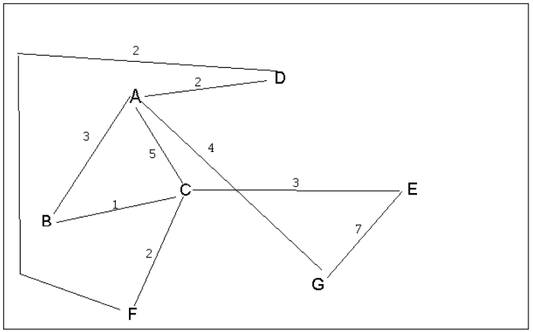
4 a. Which of the following lists the graph nodes in depth first order beginning with E?
A) E, G, F, C, D, B, A
B) G, A, E, C, B, F, D
C) E, G, A, D, F, C, B
D) E, C, F, B, A, D, G
4 b. Which of the following lists the graph nodes in breadth first order beginning at F?
A) F, C, D, A, B, E, G
B) F, D, C, A, B, C, G ← Is this an error? Is one supposed to be an E?
C) F, C, D, B, G, A, E
D) a, b, and c are all breadth first traversals

Slide 4
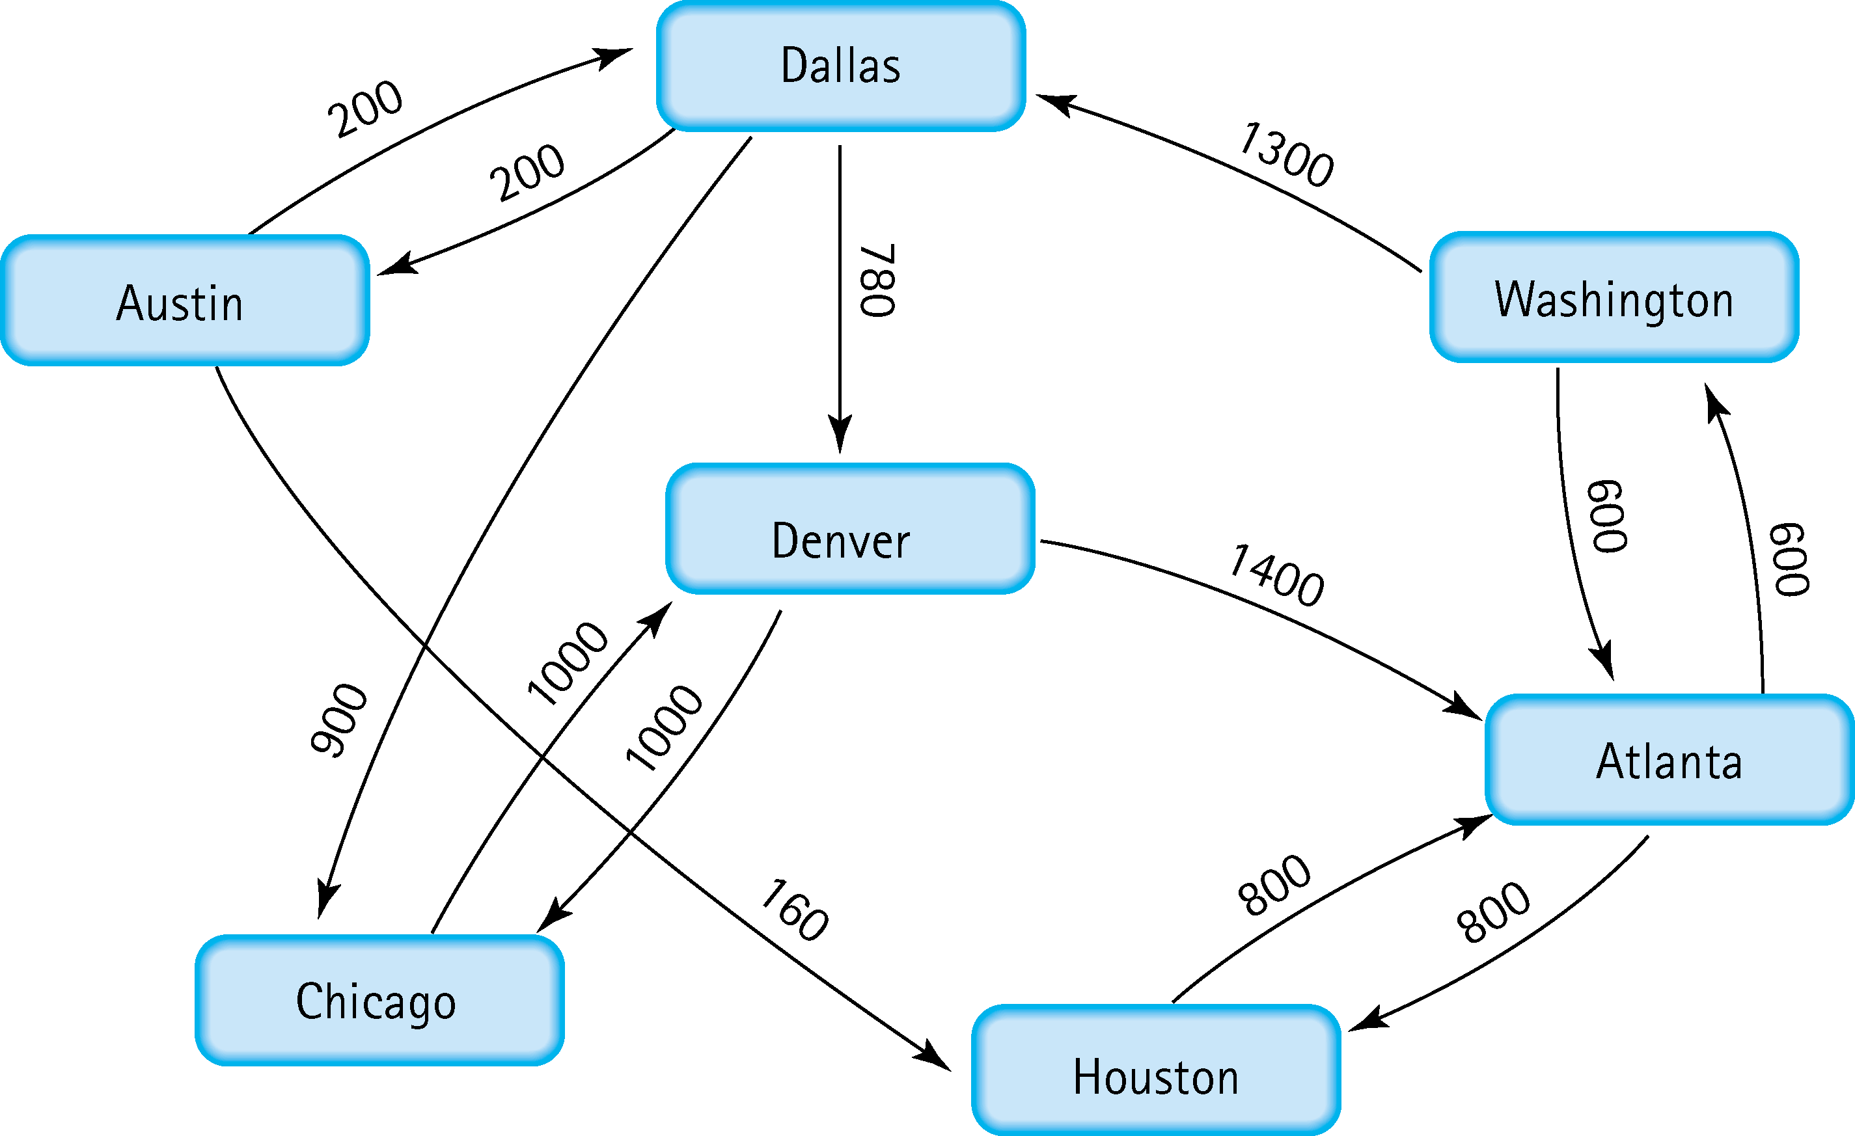
5. Find the shortest distance from Atlanta to every other city
Atlanta → Austin : 600 + 1300 + 200 = 2100
Atlanta → Chicago : 600 + 1300 + 900 = 2800
Atlanta → Dallas : 600 + 1300 = 1900
Atlanta → Denver : 600 + 1300 + 780 = 2680
Atlanta → Houston : 800
Atlanta → Washington : 600

Slide 5
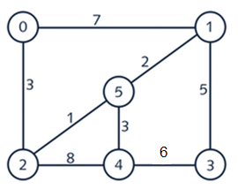
6. Find the minimal spanning tree using Prim’s algorithm. Use
0 as the source vertex . Show the steps.
Starting with the Source vertex, add vertices to the MST by following the smallest weighted edge that connects between the two.
Start at Vertex 0
Consider [V1, E7] and [V2, E3] – add [V2, E3] to the MST
Consider [V1, E7], [V5, E1], and [V4, E8] – add [V5, E1] to the MST
Consider [V1, E7], [V1, E2], [V4, E3], [V4, E8] – add [V1, E2] to the MST
Consider [V4, E3], [V4, E8], [V3, E5] – add [V4, E3] to the MST
Consider [V3, E5] and [V3, E6] – add [V3, E5] to the MST

Slide 6
7. Find the minimal spanning tree using Kruskal’s algorithm.
Show the weights in order and the steps.
V – 1 = 5 edges
Sorted Order:
Weight | Vertices
1 | 2 – 5
2 | 1 – 5
3 | 0 – 2
3 | 4 – 5
5 | 1 – 3
6 | 3 – 4
7 | 0 – 1
8 | 2 – 4
Pick weight 1, [2 – 5], no cycle, add to MST
Pick weight 2, [1 – 5], no cycle, add to MST
Pick weight 3, [0 – 2], no cycle, add to MST
Pick weight 3, [4 – 5], no cycle, add to MST
Pick weight 5, [1 – 3], no cycle, add to MST
MST now equals 5, so stop process because:
Pick weight 6, [3 – 4], cycle, discard
Pick weight 7, [0 – 1], cycle, discard
Pick weight 8, [2 – 4], cycle, discard

Slide 7
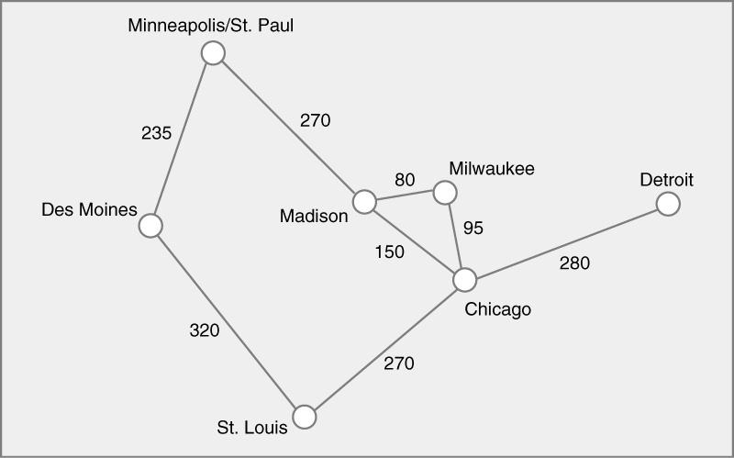
8. Find the minimal spanning tree using the algorithm you prefer. Use
Minneapolis/St. Paul as the source vertex

Slide 8
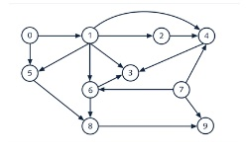








9. List the nodes of the graph in a breadth first topological ordering. Show the
steps using arrays predCount, topologicalOrder and a queue
[0] [1] [2] [3] [4] [5] [6] [7] [8] [9]
predCount
0 | 0 | 0 | 0 | 0 | 0 | 0 | 0 | 0 | 0
[0] [1] [2] [3] [4] [5] [6] [7] [8] [9]
topoOrder
0 | 7 | 1 | 2 | 5 | 6 | 4 | 8 | 3 | 9
queue
0, 7, 1,2, 5, 6, 4, 8, 3, 9

Slide 9

10. List the nodes of the graph in a breadth first topological ordering.
queue
predCount
S
DM
P1
P2
CO
A
HL
OS
TC
C
SS
E
S DM P1 P2 CO A HL OS TC C SS E
0 | 1 | 1 | 2 | 1 | 1 | 1 | 1 | 1 | 1 | 4 | 1
0 | 0 | 0 | 2 | 1 | 1 | 1 | 1 | 1 | 1 | 4 | 1
0 | 0 | 0 | 1 | 1 | 1 | 1 | 1 | 1 | 1 | 4 | 1
0 | 0 | 0 | 0 | 0 | 1 | 1 | 1 | 1 | 1 | 4 | 1
0 | 0 | 0 | 0 | 0 | 0 | 0 | 1 | 1 | 1 | 4 | 1
0 | 0 | 0 | 0 | 0 | 0 | 0 | 0 | 1 | 1 | 4 | 1
0 | 0 | 0 | 0 | 0 | 0 | 0 | 0 | 0 | 1 | 4 | 1
0 | 0 | 0 | 0 | 0 | 0 | 0 | 0 | 0 | 1 | 3 | 1
0 | 0 | 0 | 0 | 0 | 0 | 0 | 0 | 0 | 0 | 2 | 1
0 | 0 | 0 | 0 | 0 | 0 | 0 | 0 | 0 | 0 | 1 | 1
0 | 0 | 0 | 0 | 0 | 0 | 0 | 0 | 0 | 0 | 0 | 1
topoOrder
S | DM | P1 | P2 | CO | A | HL | OS | TC | C | SS | E

